Slide 1

Selectivity Estimation for Fuzzy String Predicates in Large Data Sets
Liang Jin and Chen Li
VLDB’2005
Supported by NSF CAREER Award IIS-0238586

Slide 2

Example: a movie database
“Find movies starred Schwarrzenger”?
Find movies with a star “similar to” Schwarrzenger.
Star | Title | Year | Genre
Keanu Reeves | The Matrix | 1999 | Sci-Fi
Samuel Jackson | Star Wars: Episode III - Revenge of the Sith | 2005 | Sci-Fi
Schwarzenegger | The Terminator | 1984 | Sci-Fi
Samuel Jackson | Goodfellas | 1990 | Drama
… | … | … | …

Slide 3
Queries with Fuzzy String Predicates
Stars: name similar to “Schwarrzenger”
Employees: SSN similar to “430-87-7294”
Customers: telephone number similar to “412-0964”
Similar to:
  a domain-specific function
  returns a similarity value between two strings
Example: edit distance
  Ed(s1,s2): minimum # of operations (insertion, deletion, substitution) to change s1 to s2
  ed(Tom Hanks,
  Ton Hank ) = 2
Database

Slide 4
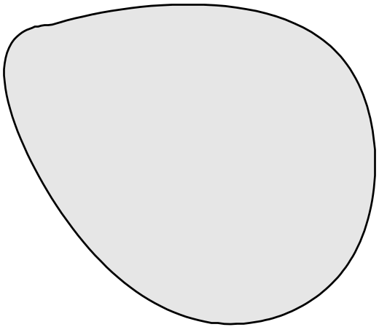
Selectivity Estimation: Problem Formulation
Input: fuzzy string predicate P(q, δ)
star SIMILARTO ’Schwarrzenger’
A bag of strings
Output: # of strings s that satisfy dist(s,q) <= δ

Slide 5
Why Selectivity Estimation?
SELECT *
FROM Movies
WHERE star SIMILARTO ’Schwarrzenger’
AND year BETWEEN [1980,1999];
SELECT *
FROM Movies
WHERE star SIMILARTO ’Schwarrzenger’
AND year BETWEEN [1970,1971];
Movies
Star | Title | Year | Genre
Keanu Reeves | The Matrix | 1999 | Sci-Fi
Samuel Jackson | Star Wars: Episode III - Revenge of the Sith | 2005 | Sci-Fi
Schwarzenegger | The Terminator | 1984 | Sci-Fi
Samuel Jackson | Goodfellas | 1990 | Drama
… | … | … | …
The optimizer needs to know the selectivity of a predicate to decide a good plan.

Slide 6
Rest of the talk
Motivation: selectivity estimation of fuzzy predicates
Our approach: SEPIA
  Proximity between strings
  Histograms and estimation algorithm
Construction and maintenance of SEPIA
Experiments

Slide 7
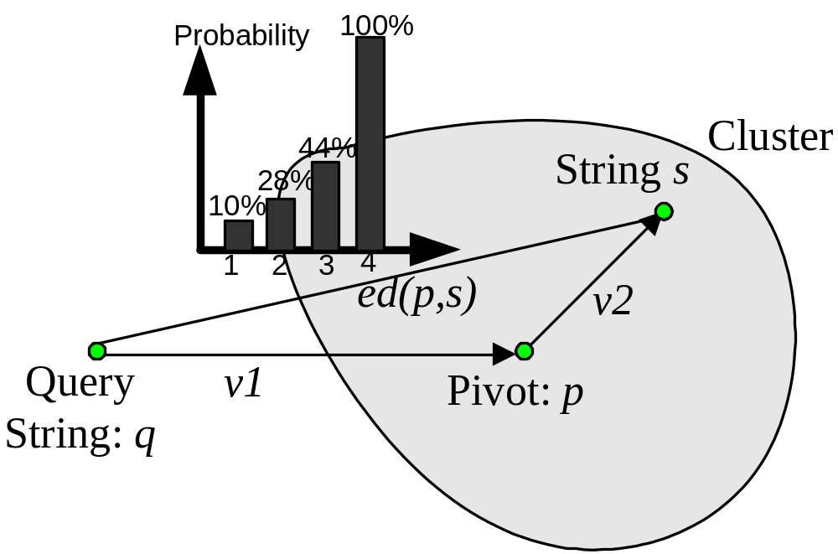
Intuition of SEPIA
Selectivity Estimation of Approximate Predicates

Slide 8
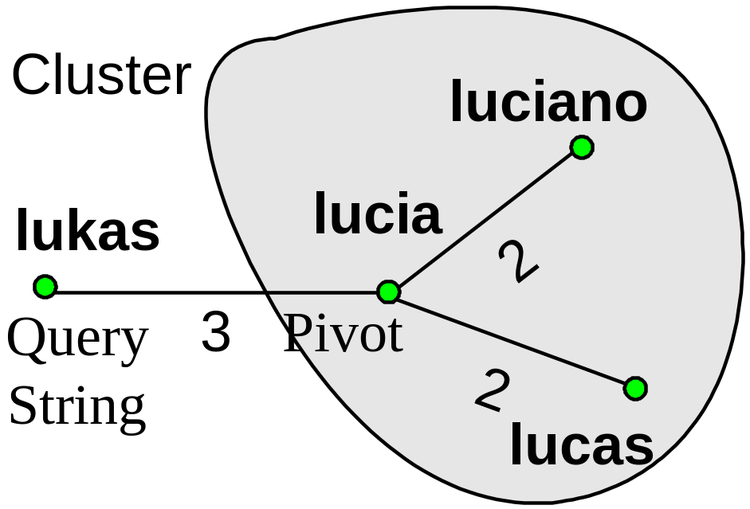
Proximity between Strings
Edit Distance? Not discriminative enough

Slide 9
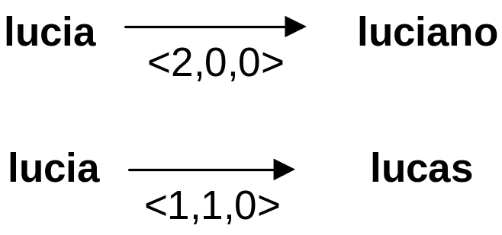
Edit Vector from s1 to s2
A vector <I, D, S>
  I: # of insertions
  D: # of deletions
  S: # of substitutions
  in a sequence of edit operations with their edit distance

Slide 10
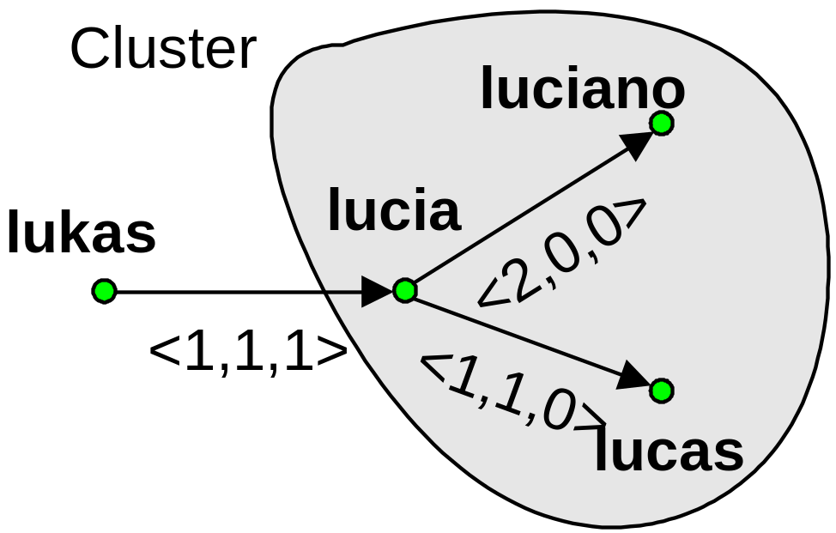
Why Edit Vector? More discriminative

Slide 11
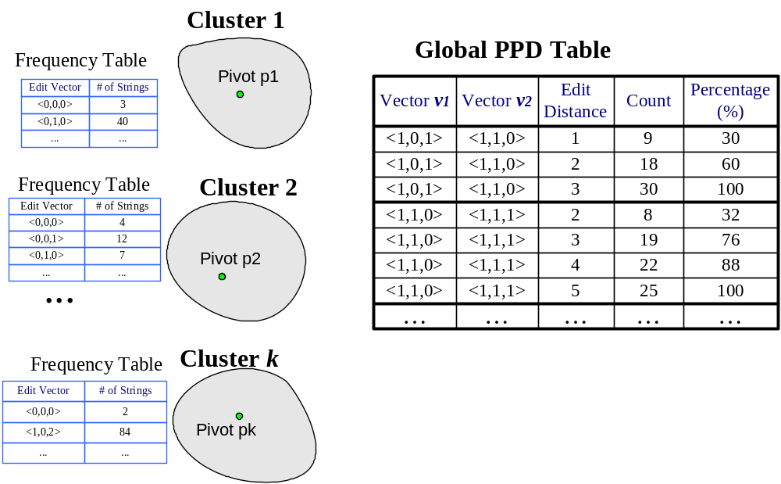
SEPIA histograms: Overview

Slide 12
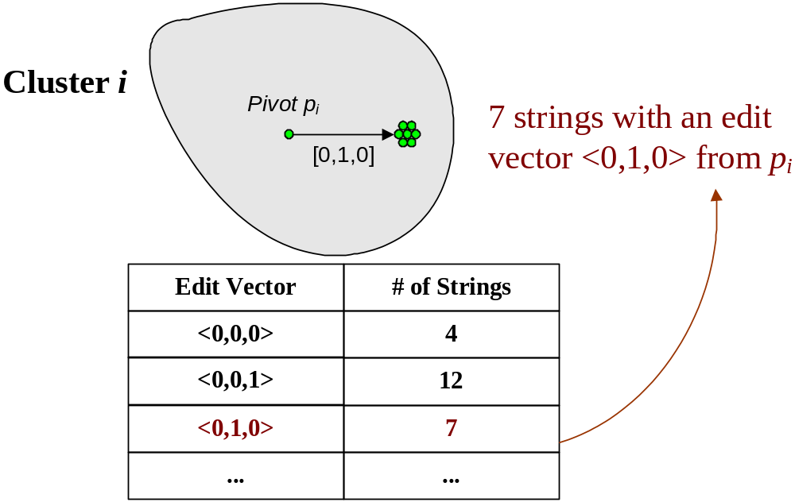
Frequency table for each cluster

Slide 13
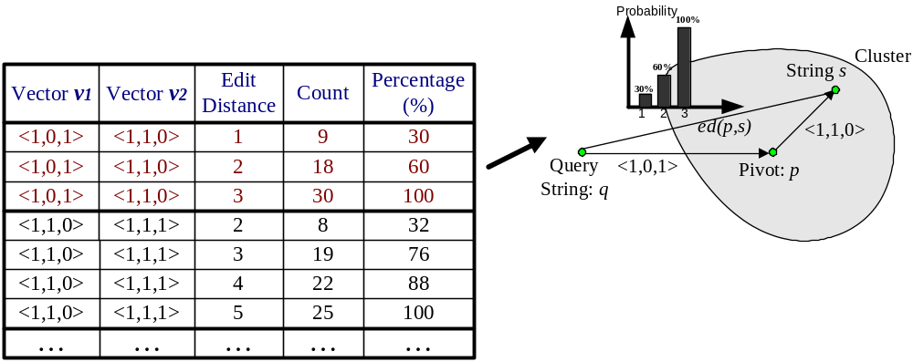
Global PPD Table
Proximity Pair Distribution table

Slide 14
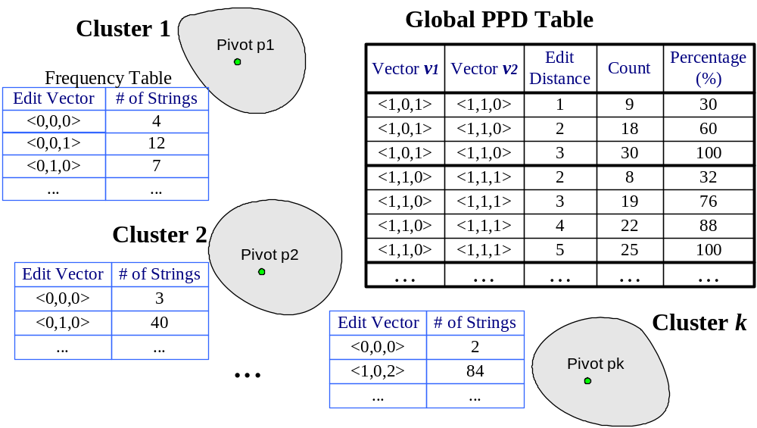
SEPIA histograms: summary

Slide 15
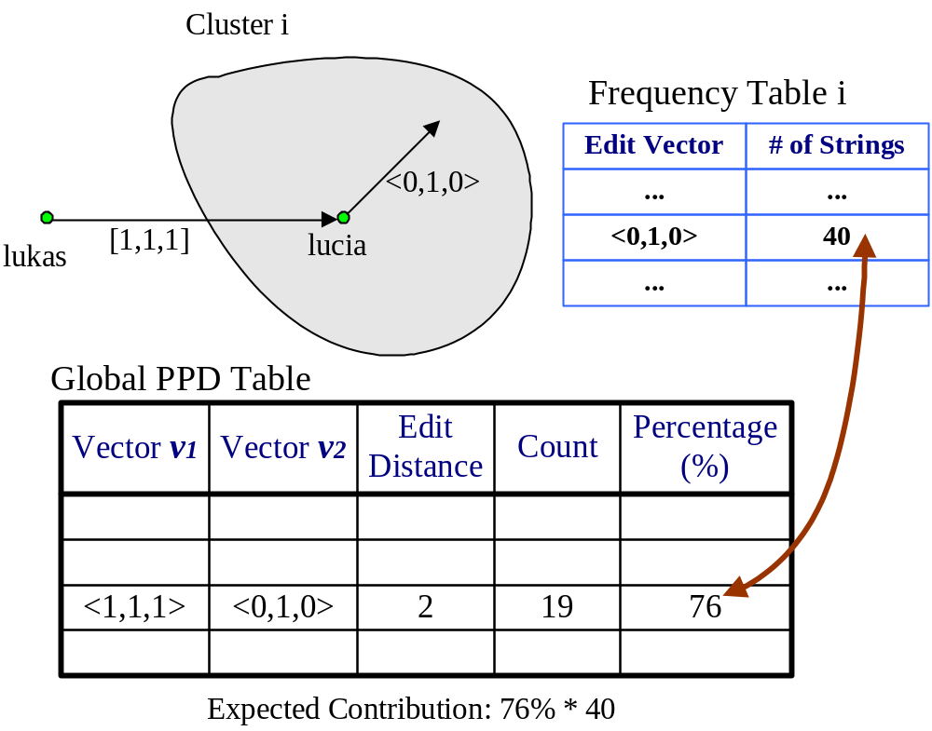
Selectivity Estimation: ed(lukas, 2)
Do it for all v2 vectors in each cluster, for all clusters
Take the sum of these contributions

Slide 16
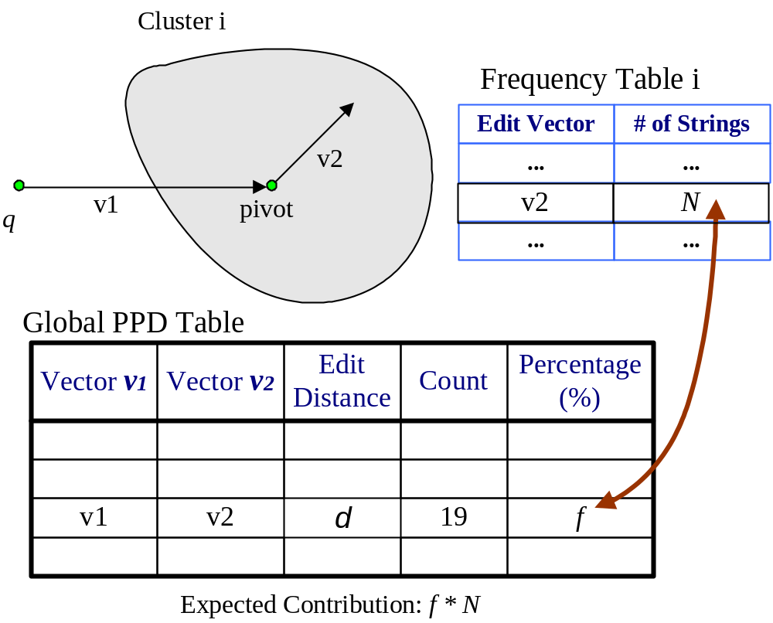
Selectivity Estimation for ed(q,d)
For each cluster C_{i}
For each v2 in frequency table of C_{i}
Use (v1,v2,d) to lookup PPD
Take the sum of these f * N
Pruning possible (triangle inequality)

Slide 17
Outline
Motivation: selectivity estimation of fuzzy predicates
Our approach: SEPIA
  Proximity between strings
  Histograms and estimation algorithm
Construction and maintenance of SEPIA
Experiments

Slide 18
Clustering Strings
Two example algorithms
Lexicographic order based.
K-Medoids
  Choose initial pivots
  Assign strings to its closest pivot
  Swap a pivot with another string
  Reassign the strings

Slide 19
Number of Clusters
It affects:
Cluster quality
  Similarity of strings within each cluster
Costs:
  Space
  Estimation time

Slide 20
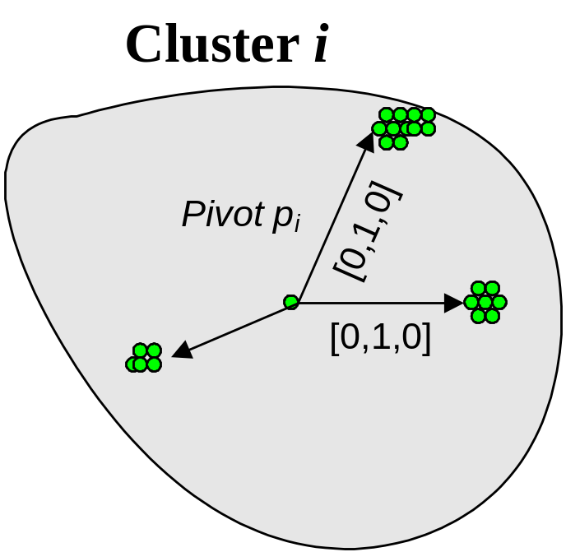
Constructing Frequency Tables
For each cluster, group strings based on their edit vector from the pivot
Count the frequency for each group

Slide 21
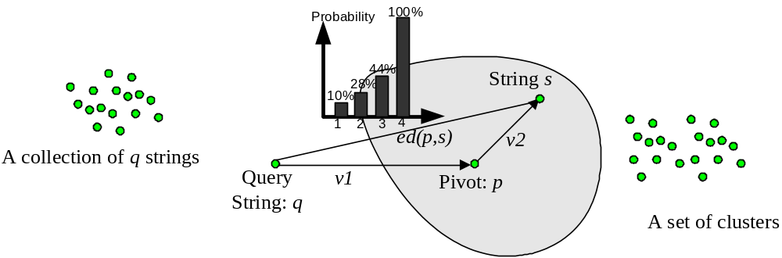
Constructing PPD Table
Get enough samples of string triplets (q,p,s)
Propose a few heuristics
  ALL_RAND
  CLOSE_RAND
  CLOSE_LEX
  CLOSE_UNIQUE

Slide 22
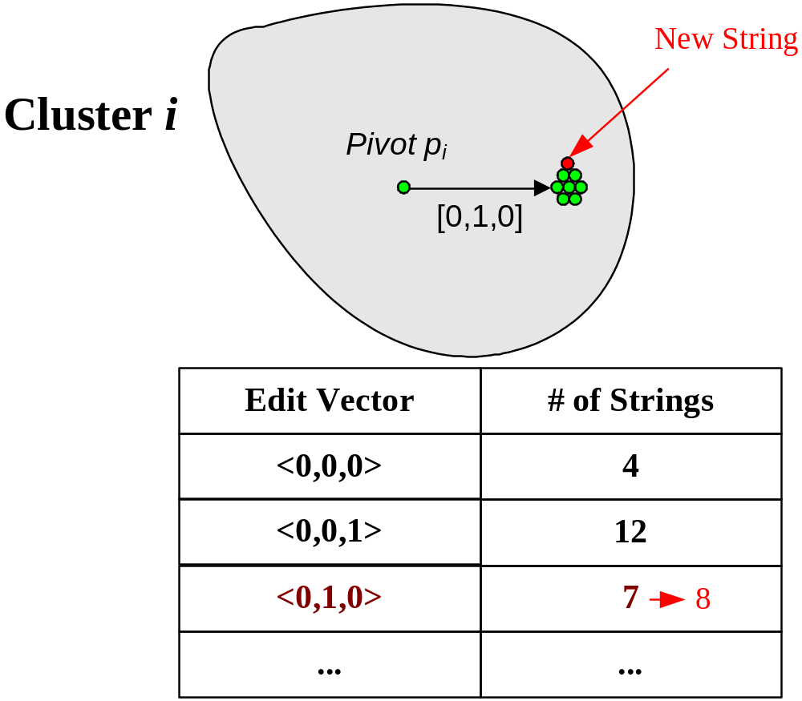
Dynamic Maintenance: Frequency Table
Take insertion as an example

Slide 23
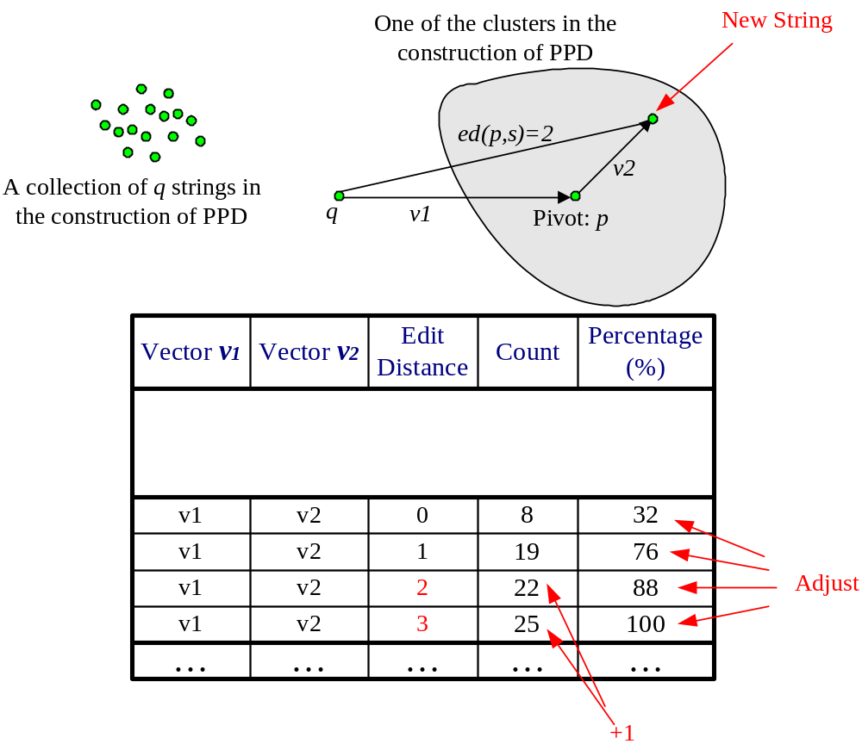
Dynamic Maintenance: PPD

Slide 24
Improving Estimation Accuracy
A post-processing step to further improve estimation accuracy
See paper for details.

Slide 25
Outline
Motivation: selectivity estimation of fuzzy predicates
Our approach: SEPIA
  Proximity between strings
  Histograms and estimation algorithm
Construction and maintenance of SEPIA
Experiments

Slide 26
Data
Citeseer:
  71K author names
  Length: [2,20], avg = 12
Movie records from UCI KDD repository:
  11K movie titles.
  Length: [3,80], avg = 35
Introduced duplicates:
  10% of records
  # of duplicates: [1,20], uniform
Final results:
  Citeseer: 142K author names
  UCI KDD: 23K movie titles

Slide 27
Setting
Test bed
  PC: 2.4G P4, 1.2GB RAM, Windows XP
  Visual C++ compiler
Query workload:
  Strings from the data
  String not in the data
  Results similar
Quality measurements
  Relative error: (fest – freal) / freal
  Absolute relative error : |fest – freal | / freal

Slide 28
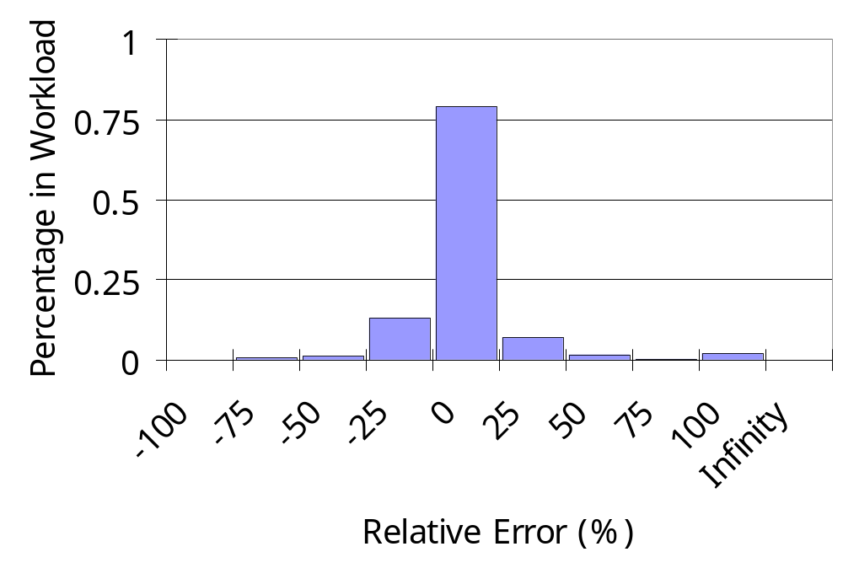
Quartile distribution of relative errors
Data set 1. CLOSE_RAND; 1000 clusters

Slide 29
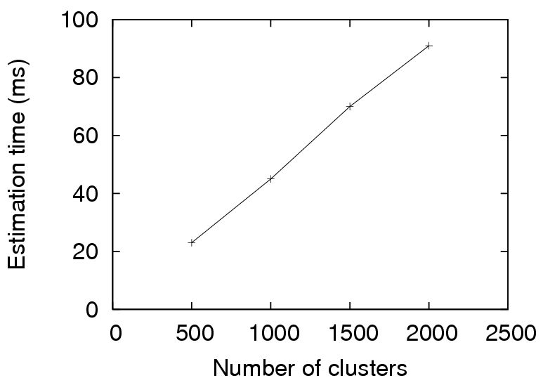
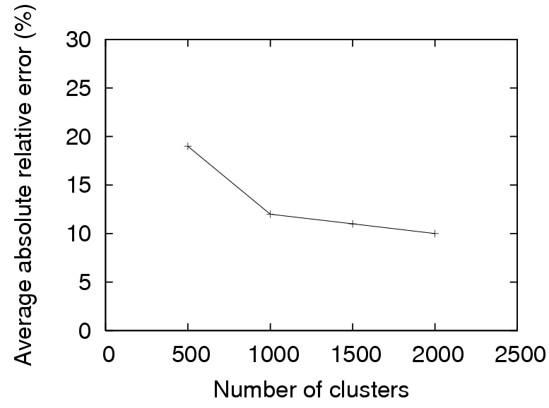
Number of Clusters

Slide 30
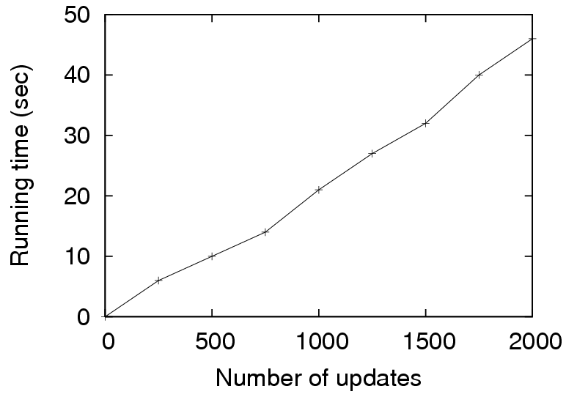
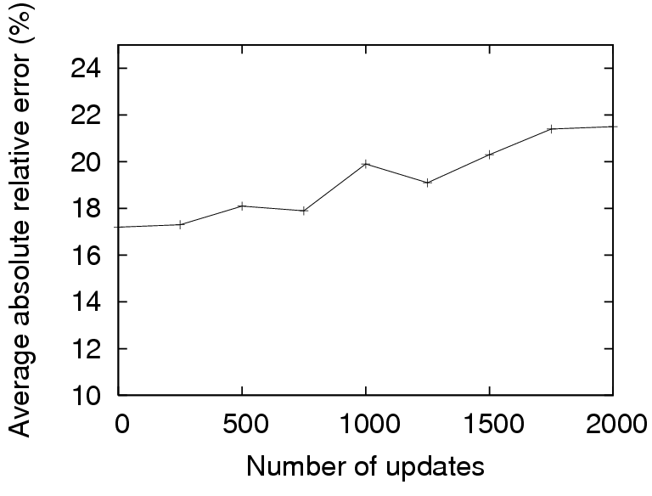
Dynamic Maintenance
More results in the paper:
Extension to other similarity functions
More experimental results

Slide 31
Related Work
Traditional histograms
Selectivity estimation for predicates with wildcards: star LIKE “%Hanks%”
Answering fuzzy predicates efficiently (another talk in this conference)

Slide 32
Conclusions
Important to support queries with fuzzy string predicates
SEPIA: provides accurate selectivity estimation
  Structures can be efficiently constructed and maintained.
  Extendable to various similarity measurements
The Flamingo Project : http://www.ics.uci.edu/~flamingo/
Q&A?

